Slide 1
Module 5: Leader of the Free World
Talk | Title | Time Period | Date of Talk
30 | Isolationism interrupted | 1939-1941 | January 20th
31 | The European War | 1941-1945 | February 3rd
32 | The Pacific War | 1941-1945 | February 17th
33 | America and the Post War World | 1945-1949 | March 3rd
34 | USA during the 1950’s | 1950-1960 | March 17th
35 | The Cold War | 1950-1960 | March 31st
36 | Camelot…the Kennedy Years | 1961-1963 | April 7th

Slide 2
The talks to follow
America in the 1950’s
March 17th
The Cold War
March 31st
1950-1960
Module 5
Leader of the Free World
(1939-1963)
Camelot
April 7th
1960-1963
“The Great Society”
TBA
Vietnam
TBA
Module 6
From Impasse to
Domination
(1963-2001)
1963-1974
Rush to the Sun Belt?
TBA
A Nation Adrift
TBA
1972-1980

Slide 3
Talk 34 USA 1950’s
Truman Second Term
Return of the Republicans
The affluent society
….Intermission
Women in the 1950’s
The forces of change

Slide 4
Truman’s Second Term

Slide 5
Second Red Scare (1947-1954)
Depression/ New Deal legitimized big role for Government
US alliance with USSR 1941-1945 encouraged US Socialists/ Communists
House Un American Activities Committee (HUAC)set up in 1938 vs Nazi spies
Change to anti communism due to Canadian spy rings, USSR & East Europe
Loyalty Oath Executive Order (Truman 1947)..public employees> media> actors
……..“I am not nor ever have been member of the Communist Party”
First Target: Hollywood

Slide 6
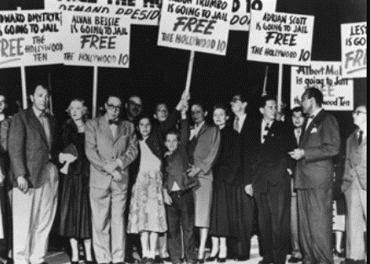
Hollywood & Loyalty Oath
‘Hollywood 10’ demonstration 1947
Loyalty Oath …1947 anyone public facing role
Hollywood factions
Informants…naming of names
Refuseniks…refused to testify
Culture of name calling
“Hollywood 10” refuse to testify
Actors/ producers/ writers summoned to
HUAC interviews….Los Angeles
Motion Picture Alliance For The Preservation
Of American ideals: “Don’t smear wealth, industrialists, profit motive, don’t glorify common man, the collective” …Ayn Rand

Slide 7
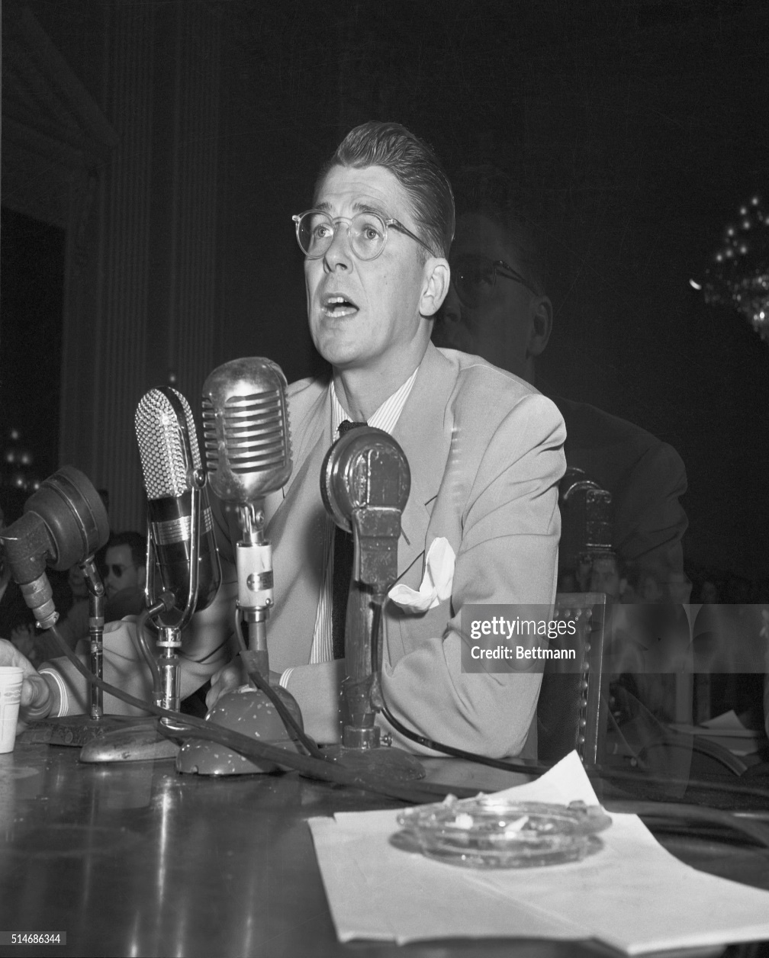
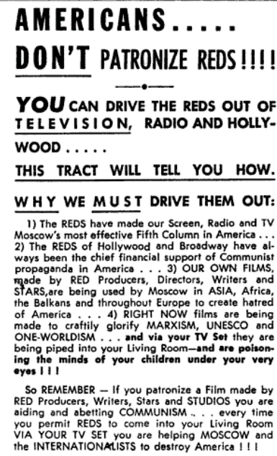
Witch hunt begins
Reagan President Screen
Actor’s Guild. Provides
names of sympathizers
Ronald Reagan testifying to
Un-American committee 1947
Ayn Rand Pamphlet 1947
Opposed by ‘Committee
For First Amendment’
…Lucille Ball
…Betty Davis
…Humphry Bogart
….interview. cleared
“Secret blacklist”
…some suicides
..flee country
…no evidence real
Paranoia fuelled by
Pumpkin Patch Case

Slide 8
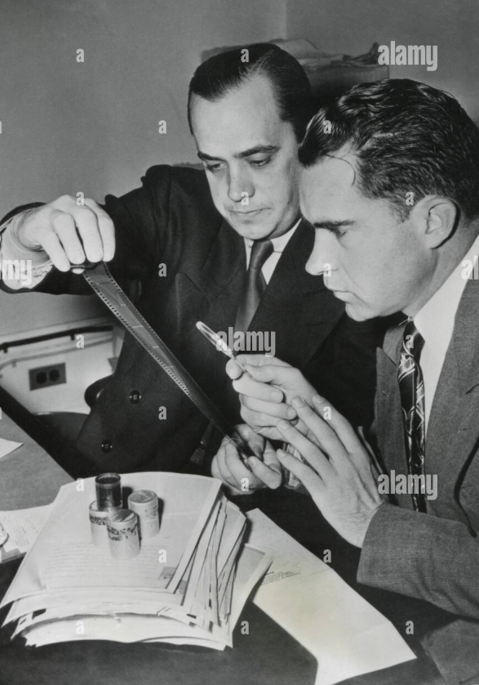
Pumpkin Patch Case 1948/49
“Ware” real Russian spy group late 1930’s
…typed copies & returned ….copies hidden in pumpkin patch
….given to KGB agents
Nixon with Chambers & microfilms
Agent defects (Chambers) …
Richard Nixon (new Congressman)
..contacts HUAC
…Chambers retrieves film
…minutes to cabinet meetings
…and air conditioning system?
Implicates Truman senior counsel
Alger Hiss….as Soviet Agent

Slide 9
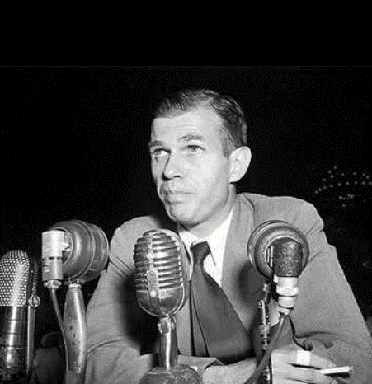
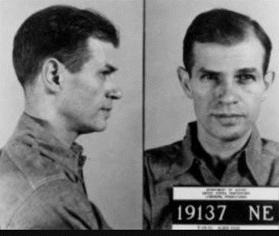
Alger Hiss Trials 1947-1948
Hiss erudite, good family
….senior access
…shock gov infiltrated
Hiss giving testimony
Mug shot
Accused of spying
…statute of limitations
Limits penalty
Convicted of perjury
1948…3 years prison
.claims innocence till death
Cause celebre for left
…1990’s soviet records
He was indeed agent

Slide 10
Atomic Spies
USSR detonates atomic bomb 1949
British/German atomic spy ring uncovered 1949 by MI5
Klaus Fuchs scientist arrested
Implicates Julius Rosenberg as Manhattan Project KGB agent

Slide 11
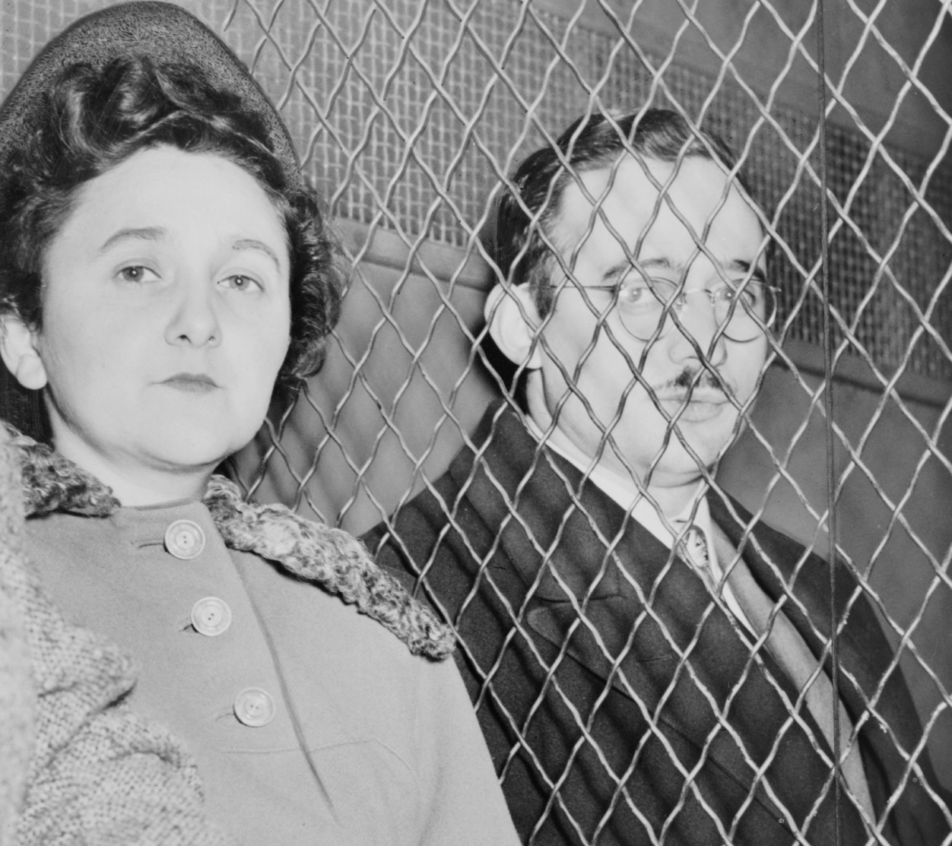
Rosenberg Case 1951
Julius son of Jewish immigrant
…joined Communist Party 1933
Ethel Greenglass..aspiring actress
…joins CPSA .marries Julius 1939
(brother engineer (Manhattan Project)
Julius and Ethel….1953
(day before execution)
Julius ..recruited by KGB 1942
..persuades brother to leek docs
Both arrested, electrocuted
….court accused of anti Semitism
….(1990 Soviet Records confirm
Key prosecutors Roy Cohn

Slide 12
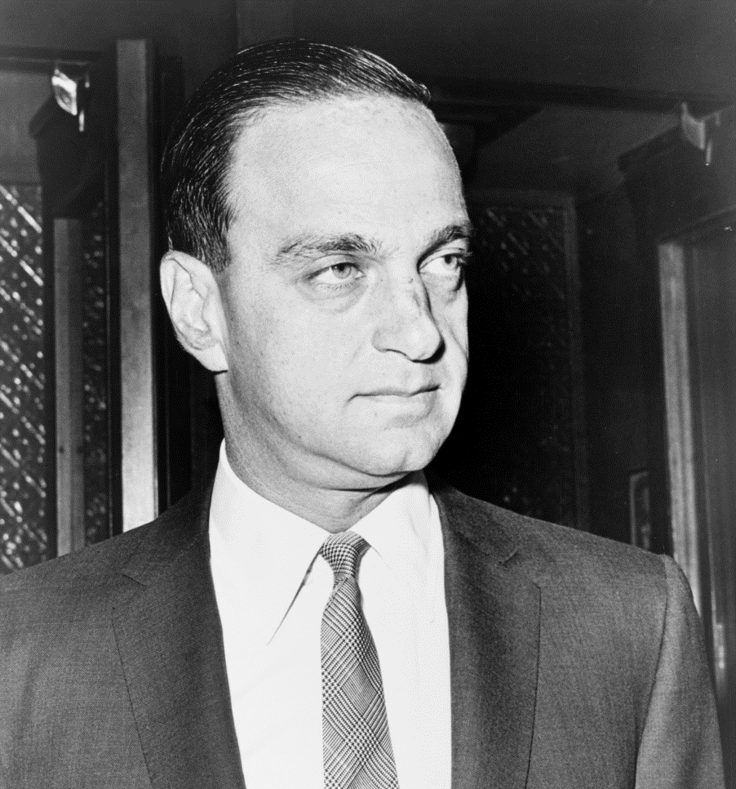
Roy Cohn (1927-1982)
Leads prosecution of Rosenberg…use of bogus evidence
Cohn and McCarthy launch “Lavender
Scare”…list of gays in government
…Truman “gay ban”…blackmail threat
Linked to mafia and concrete mixers
..”I don’t care about the law, what matters is who is the judge”.
Cohn…hired by Fred Trump in NY…. mentor to Donald Trump
Disbarred for falsifying death bed will.
….dies alone of Aids

Slide 13
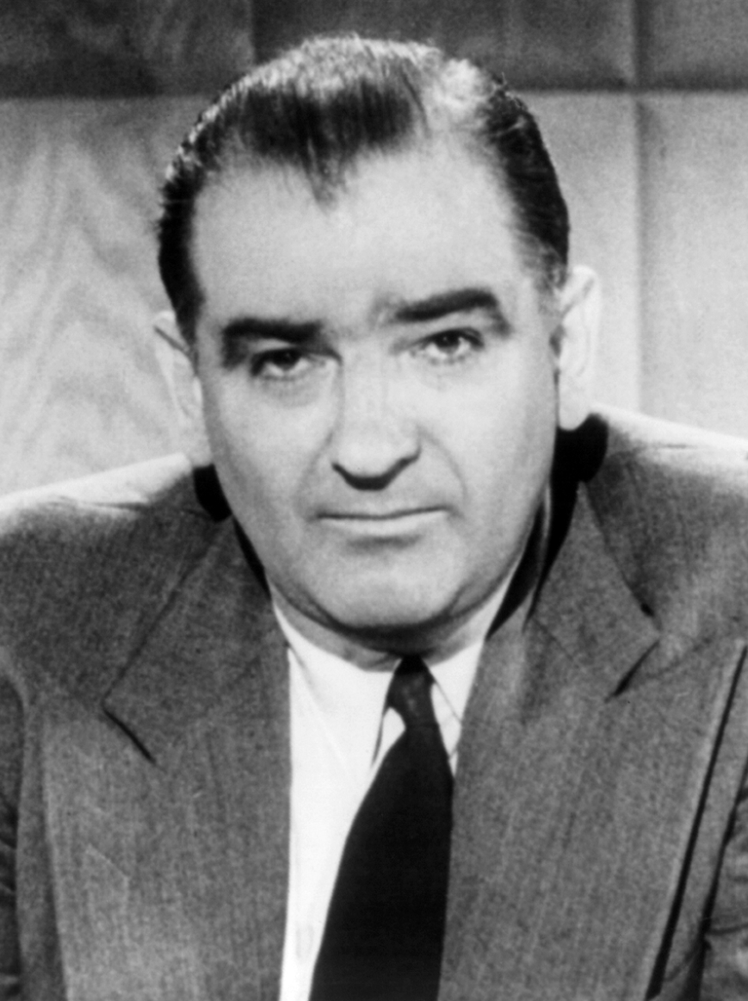
Joseph McCarthy
Dubious war record
…marines…staff
….”Tail gunner Joe”
Joseph McCarthy (1908-1957)
Senator from Wisconsin. 1946
Announces “Secret list of 203
“known communists”
…the enemy within
Accuses George Marshall Sec of
State…as spy who “lost China”
Popular…supported by new congressmen
…Richard Nixon
…Jack Kennedy
1952 Chairs Senate Committee of
Investigations…hires Roy Cohn

Slide 14
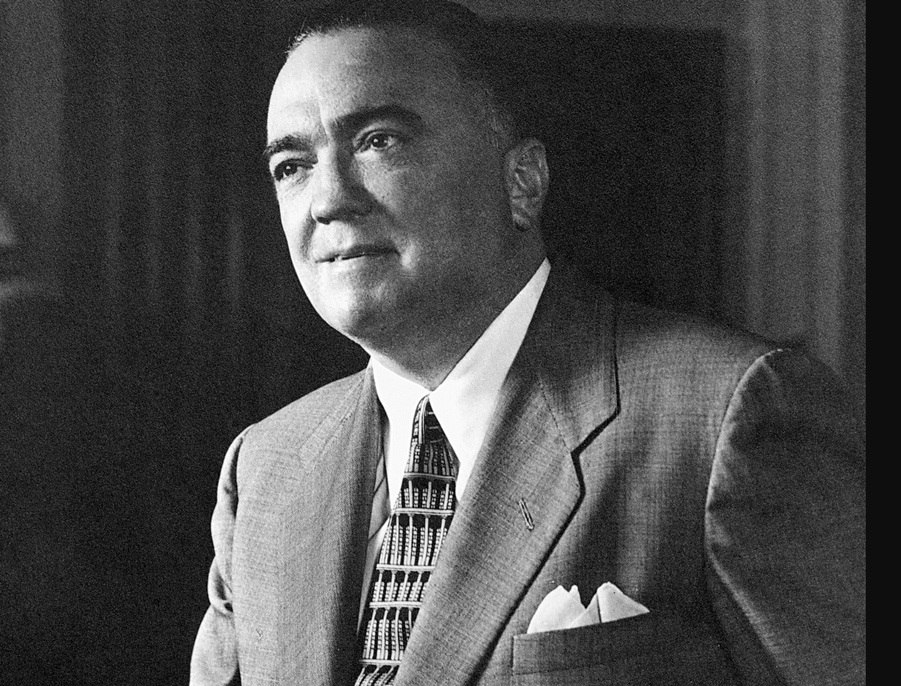
J Edgar Hoover (1895-1972)
J Edgar Hoover 1957
WW1 espionage….success
Heads Bureau of Investigation 1919
Red Scare….Head of new FBI 1931
…keeps role till death 1972
1930’s vs Capone……revolutionised
police procedure, ww2 Nazi spies…then focus 2nd Red
Scare….Lavender Scare..exposing gays
Focus on subversion, power gained by
“Red scare”, Rosenberg Case
Dominates US domestic intelligence
throughout 50’s and 60’…untouchable
Due to info on Presidents
Vs Civil Rights, slow to respond to Mafia
Syndicates…1960’s

Slide 15
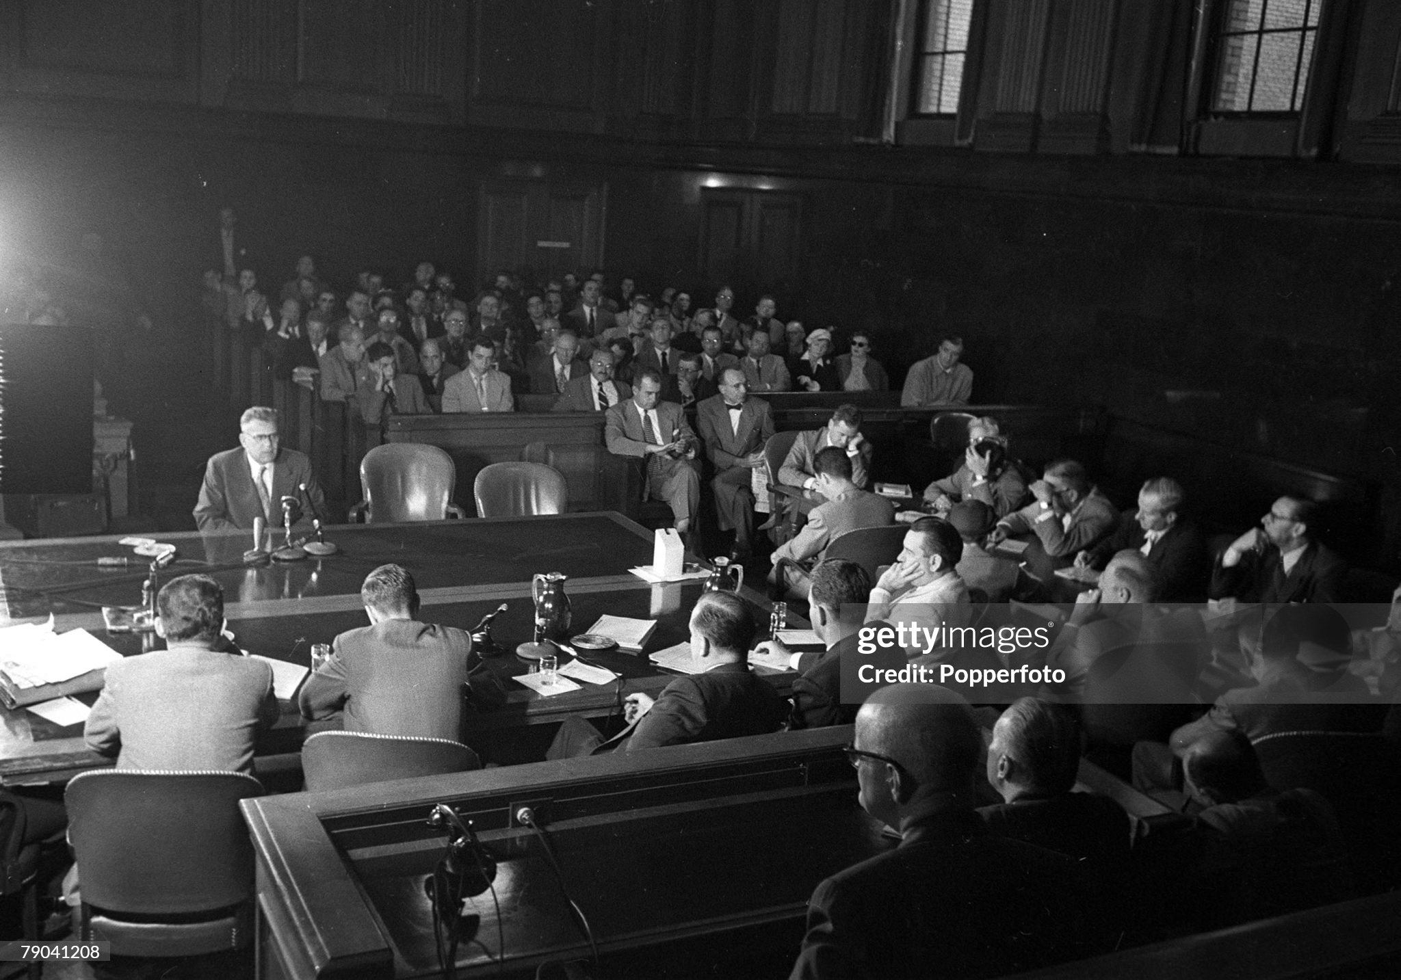
McCarthyism 1949-1955
Typical HUAC hearing (1952)
Dominates US politics
1949-1955…hires Cohn as Chief Prosecutor
Nixon
Culture of fear/ loathing
….live reporting on radio
….and television
…highly popular
…anti communist hysteria

Slide 16
Truman Second Term (1948-1952)
Getting shot at
Korean War (1950-1953)
dominates domestic agenda…”Fair Deal” shelved
To be discussed Talk 35
H Bomb testing programme conducted 700x larger than bomb on Nagasaki (Talk 35)
Creation of NATO: Eisenhower brought out of retirement…sent to Europe to set up…. USSR creates Warsaw Pact
Scandals discredit Administration
5% Commission Men
Deep freezer and presents to Truman’s staff….Hoover reveals

Slide 17
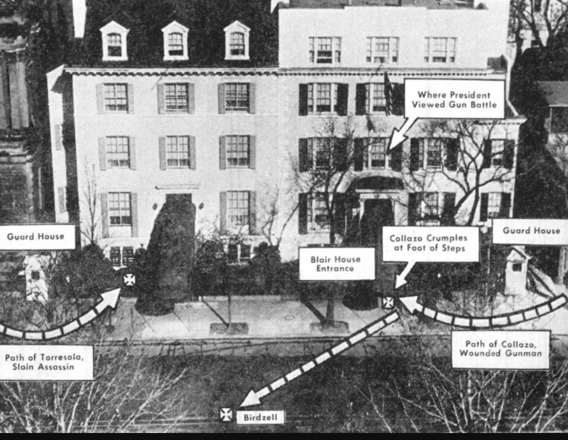
Truman Attempted Assassination: November 1950
Puerto Rico Nationalist
Want independence
Truman staying at
Blair House (WH renovations)
2 assassins attack
…gun battle, 1 killed, 1 security officer killed
Truman..not scared “I’ve
Already been shot at by
Professionals. (WW1)

Slide 18
Rise of the Republicans

Slide 19
Election of 1952
Democrats in power for 20 years…public in mood for change
Truman reputation sinks: “soft on communism”, “ man who “lost China,” scandals
Truman decides to not run a 3rd Term (21st Amendment: Truman “grandfathered”
….offers candidacy to War Hero, Allied Supreme Commander Eisenhower ………..declines, busy with NATO, claims to belong to no party
1952 election…the big fight … Isolationists and Internationalists
………………..within Republican Party

Slide 20
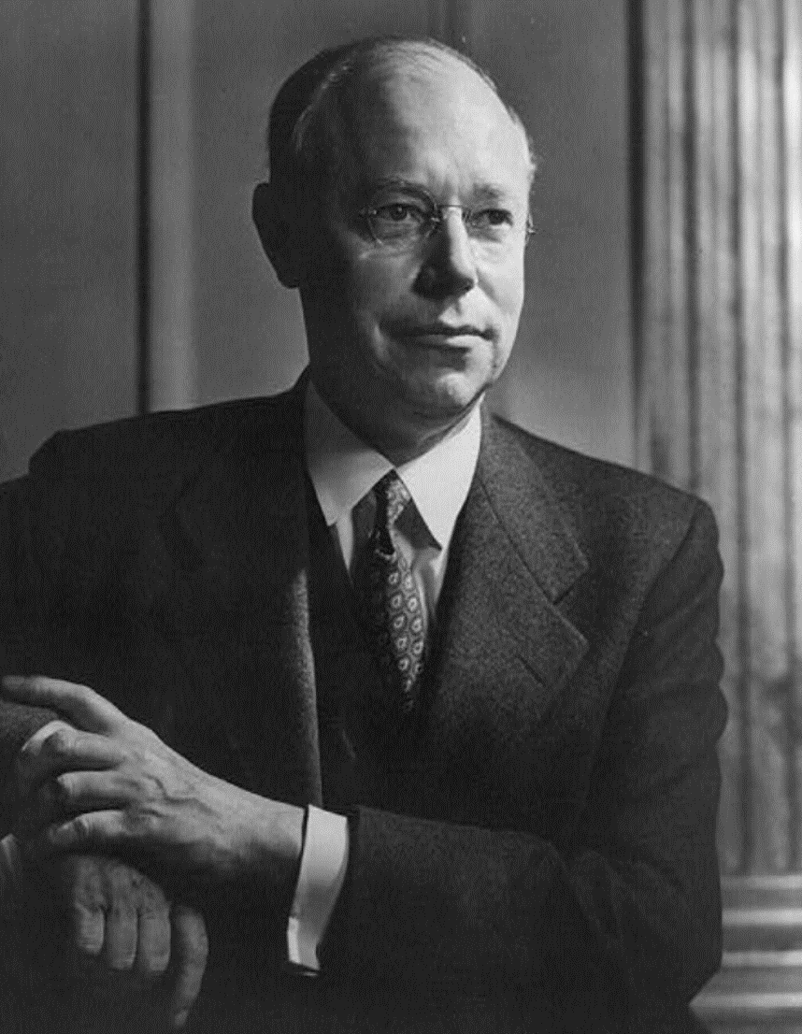
Mr Republican
Oldest son William Howard Taft, President
1908-1912, Supreme Court Justice
Robert Taft (1889-1954): Mr Republican
Opposed New Deal due to waste, bureaucracy
…supports Social Security, fair Trade Union law, medical
Aid to the poor
Opposed US involvement ww2, Lend Lease
..till Pearl Harbour…opposes internment
Opposes NATO, United Nations, Marshall Plan
…USSR no threat to US due to ocean & US air/naval
Power, Korean war ‘triggered unintentionally by US
Arming S Korea
`,

Slide 21
Isolationist on track to win GOP nomination
Robert Taft: the isolationist: “we are really trying to arm the world against Communist Russia, or at least furnish all the assistance which can be of use to them in opposing Communism. Is this policy of uniting the free world against Communism in time of peace going to be a practical long-term policy? I have always been a sceptic on the subject of the military practicability of NATO. ... I have always felt that we should not attempt to fight Russia on the ground on the Continent of Europe any more than we should attempt to fight China on the Continent of Asia.[“
On track to win Republican Nomination…June 1952
Internationalists turn to Eisenhower (NATO Supreme Commander” and war hero
…..Draft Ike campaign
…..Eisenhower agrees to join Republican Party and seek nomination

Slide 22
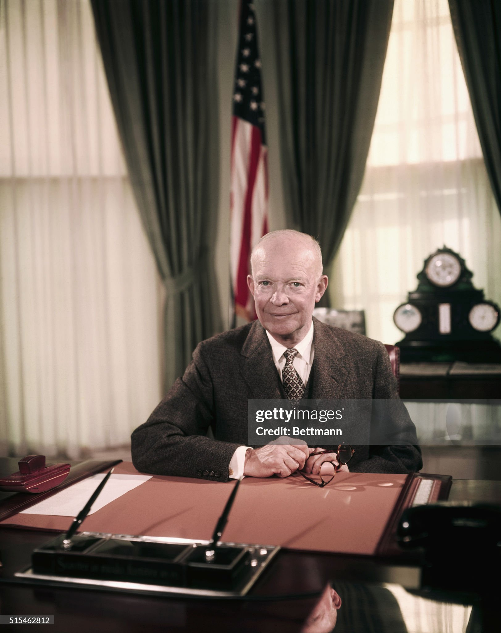
Dwight Eisenhower (1890-1968)
Eisenhower 1942
No political experience
Staff Officer/ Trainer. Master
Organiser and diplomat
Commander Allied Forces in
Europe 1942-1945
President Columbia University
1948=1950..writes memoires
“Crusade in Europe”
National Hero…wins GOP Nomination
…select Richard Nixon as Vice President
….youth, Pumpkin Papers
….virulent anti communist

